Slide 1
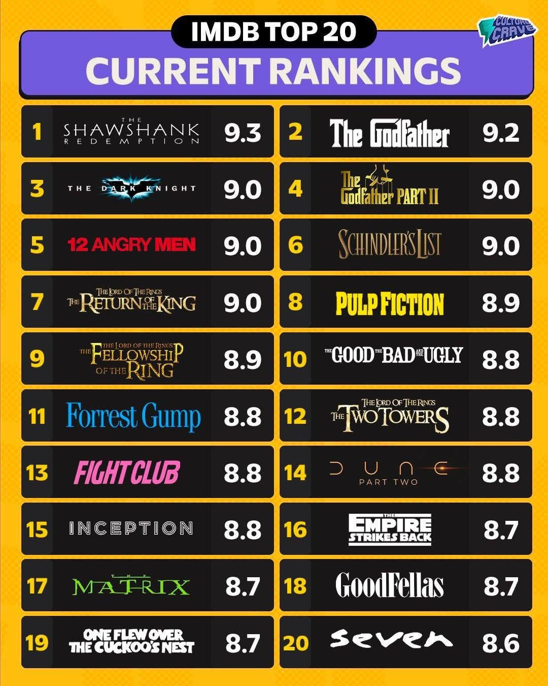
Moviemeter
By: Hunter Smith, Guillermo Flores, Darien Walker

Slide 2
Rubric 1
1. Content and Understanding (30 points)
• Problem Definition (10 pts):
Clearly explains the problem being addressed and why it is important or relevant.
o 10: Exceptionally clear and insightful
o 8: Clear, with good context
o 6: Somewhat vague or incomplete
o 4: Poorly defined or unclear
• AI Methodology and Approach (10 pts):
Demonstrates understanding of AI methods (e.g., ML model, NLP, computer vision, etc.)
and explains how they are applied.
o 10: Strong understanding and clear explanation
o 8: Adequate explanation, minor gaps
o 6: Basic mention with limited understanding
o 4: Unclear or incorrect description
• Results and Analysis (10 pts):
Shows evidence of testing, results, or demonstrations; interprets findings logically.
o 10: Comprehensive results with analysis
o 8: Reasonable results and interpretation
o 6: Limited results or unclear explanation
o 4: Missing or poorly interpreted results

Slide 3
Rubric 2 (Design and Delivery)
2. Slide Design and Organization (25 points)
• Clarity and Flow (10 pts):
Slides are well-structured and easy to follow. Logical sequence from problem → method
→ results → conclusion.
• Visual Design (10 pts):
Appropriate use of visuals, figures, and text. Balanced, readable, and professional-
looking.
• Proper Attribution (5 pts):
Sources, data, and tools are properly cited on slides.
3. Presentation Delivery (30 points)
• Oral Communication (10 pts):
Clear, confident speaking; appropriate pacing; avoids reading directly from slides.
• Team Collaboration (10 pts):
All team members contribute meaningfully; balanced participation.
• Engagement and Questions (10 pts):
Maintains audience interest, handles questions thoughtfully.
4. Professionalism and Timing (15 points)
• Adherence to Time Limit (5 pts):
Presentation stays within the allotted time (e.g., 8–10 minutes).
• Professional Conduct (5 pts):
Shows preparedness, enthusiasm, and respect.
• Technical Readiness (5 pts):
Slides, demos, and transitions run smoothly without major technical issues.
Total: 100 points
Notes: Grades for each member in a group may differ according to contributions in work
and presentation delivery

Slide 4
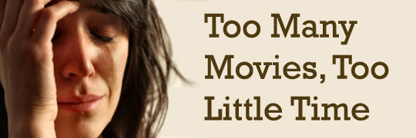
Problem Definition
There is too many movies out there which go under the radar. We don’t want to waste the few free hours searching through a million movies or even worse, watching a bad movie.
The goal is to provide a recommendation website that invites the user to find new things they enjoy in an efficient setting.
Notes:
It’s simple, there is too many movies out there which go under the radar. We don’t want to waste the few free hours searching through a million movies or even worse, watching a bad movie.

Slide 5

Solution?
Notes:
AI Machine Learning! Instead of spending endless time searching for new movies. We can use AI Machine Learning to find good matches based on a users’ likes!
This project seeks to solve the problem of content overload by delivering accurate, personalized movie recommendations that improve user experience, reduce browsing time, and enhance overall satisfaction.

Slide 6
AI Methods and Methodology
Scalable storage: Supabase enables reliable retrieval and deployment of recommendation data.
Collaborative filtering (SVD) effectively extracts underlying user–movie preference patterns.
Automated training and batch insertion support periodic refresh cycles for evolving user interactions.
Efficient preprocessing and batching ensure low computational overhead and maintainability.
Notes:
This script trains a movie recommendation model using SVD (Singular Value Decomposition) from the surprise ML library.
It learns which movies users might like based on what they already liked.
Then it saves predicted recommendations into a Supabase table.
learns user latent factors
learns movie latent factors
uses stochastic gradient descent to minimize prediction error
predicts user ratings for unseen movies

Slide 7
Scoring
Collaborative Filtering via SVD (from Surprise library)
This learns user preferences from your liked_movies table.
Content & popularity signals
These come from TMDB rating and genre overlap.
Hybrid scoring
All three (SVD + genre + TMDB rating) are blended to produce the final recommendation score.

Slide 8

How the Hybrid Model works ?
1. Loads environment and connects to Supabase
2. Fetch users’ liked movies from DB
3. Converts likes into ratings dataframe
4. Builds a Surprise Dataset
5. Train on SVD model (Learns latent vector per user and per movie)
6. Fetch Thousands of movies from TMDB
7. Build clean TMDB movie log
8. Extract users’ favorite genres
9. Score every movie for every user
10. Pick top 20 movies for each user
11. Deduplicates
12. Deletes Old Recommendations
13. Upload New Recommendations
Notes:
#9 – Skips already liked, uses SVD score, checks how many genres match, tmdb rating, combines into hybrid score.
Result ✔️ Collaborative filtering (SVD)
✔️ Content-based filtering (genres)
✔️ Popularity ranking (TMDB rating)

Slide 9
Analysis on Effectiveness of Hybrid Movie System
Accuracy of predictions generated by the SVD model
Quality of recommended movies for different types of users
Coverage — whether the system recommends movies across many genres
Novelty — ensuring movies the user already liked are excluded
Performance — runtime and scalability when analyzing large TMDB datasets

Slide 10
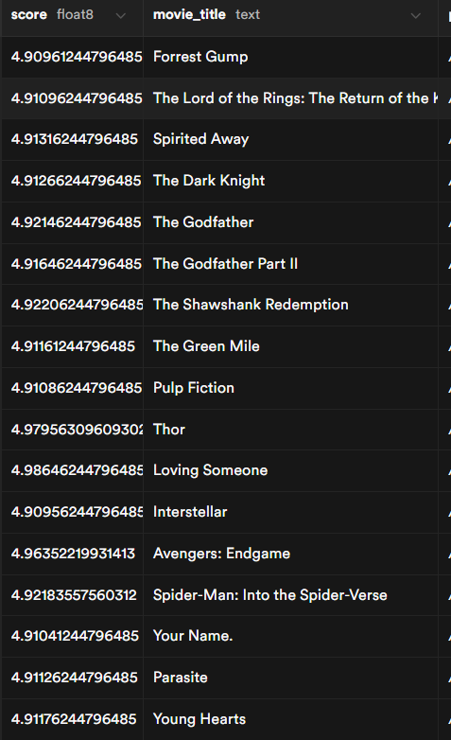
Accuracy of Predictions
Current implementation gives huge favor to SVD model which is accurate but not the most unique due to low dataset. Because of this, good movies are recommended but do not vary to each user.

Slide 11
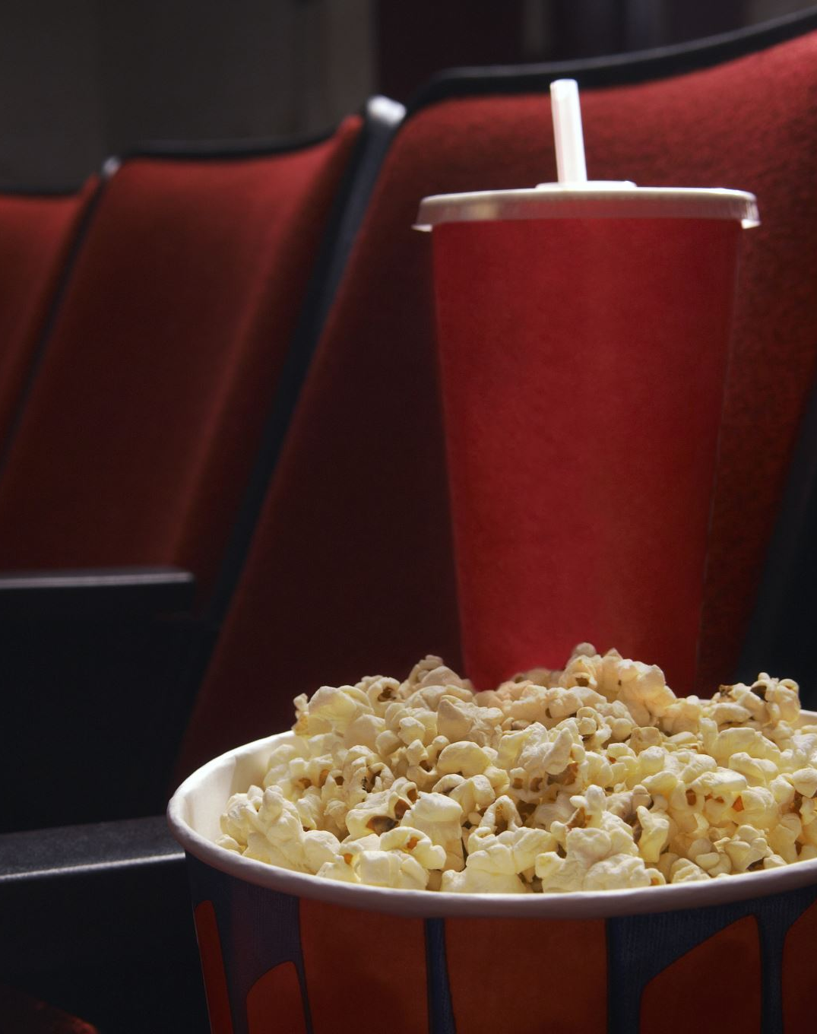
Quality of recommended movies
Quality movies are being recommended but Quality of movies recommended are not catered enough to user.

Slide 12
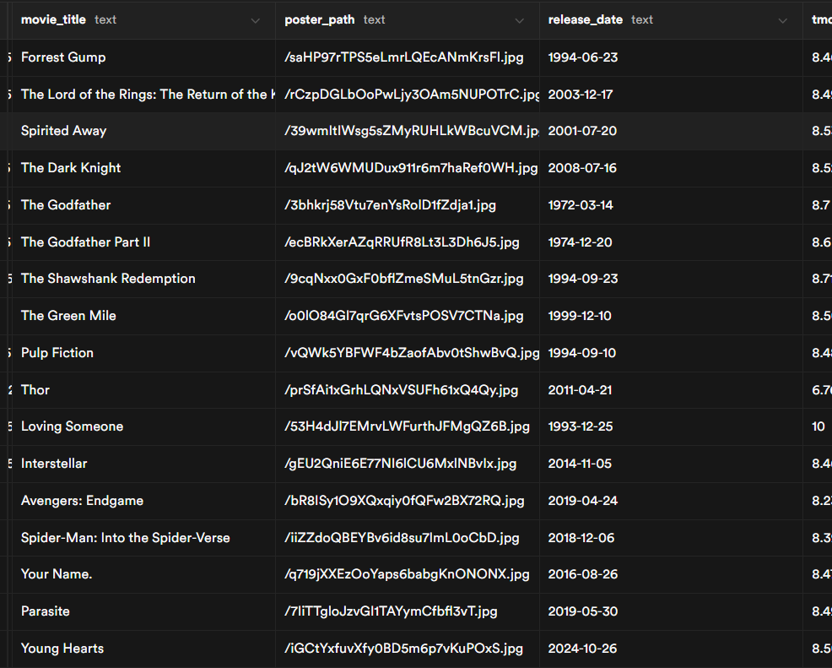
Coverage
The recommendations are spread across multiple genres including Comedy, Action, Sci-Fi, Romance, etc
Notes:
whether the system recommends movies across many genres

Slide 13

Novelty
The system ensures that liked movies will not be recommended.
Future implementation would add a weekly reset where previously recommended movies would have a timeout
Notes:
ensuring movies the user already liked are excluded

Slide 14
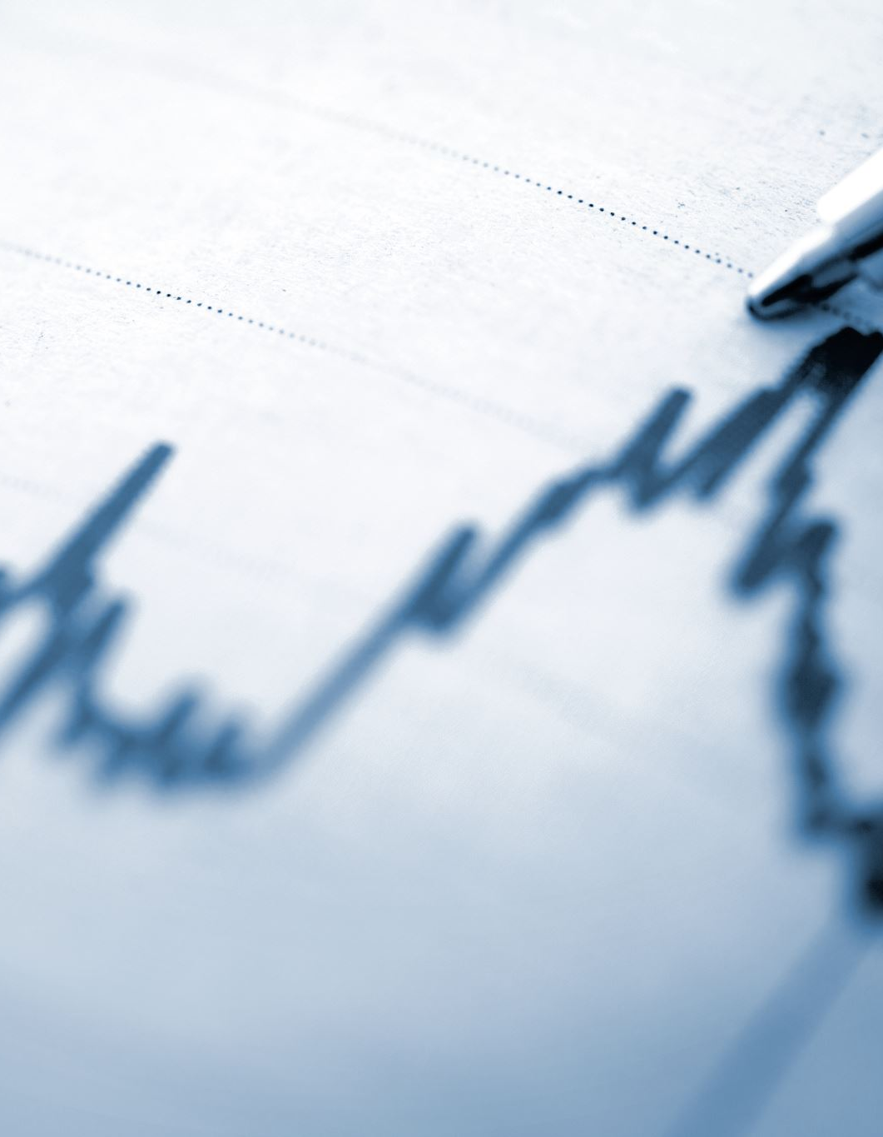
Performance
Recommendation Model runs quick between 20-50 popular pages. 500 pages (14,000 movies) can take a larger amount of time. Low
Improved algorithms would be needed with large user scaling.
Notes:
runtime and scalability when analyzing large TMDB datasets

Slide 15
Overall Results and Analysis
Pros
The AI pipeline runs successfully: data retrieval, model training, prediction generation and database upload.
SVD model produces personalized recommendations based on user rating history.
Recommendations exclude previously liked movies and align with user genre/taste patterns.
Backend is stable: Supabase tables sync correctly, batch inserts work efficiently, and no runtime errors occur.
User experience improves. Movies are easier to find, search time is reduced, and recommendations update instantly after new likes.
Overall, MovieMeter is fully functional, reliable, and ready for real user usage and scaling.
Cons
SVD currently performs on likes of users. A user rating movies (1-10) would result in a better input set to work on.
SVD excels on large data results. There is not enough current data (users and movies liked) to be the most effective recommendation system.

Slide 16

Demo

Slide 17

Questions?

